Slide 1
Music- Genre classification system using ML
Prof. Shucheng Yu
CPE 695 WS

Slide 2
Contents
Introduction
Objective
Data Analysis
Data Preprocessing
Data Visualization
Machine Learning Model Implementation.
4.1 K-means Clustering
4.2 SVM
4.3 Random Forest
5. Conclusion

Slide 3
Introduction
Manual classification of music genres is time-consuming and subjective, leading to inconsistent results.
The project aims to create an accurate and effective system for automatic genre classification using machine learning algorithms and audio parameters.
Various machine learning algorithms and clustering strategies will be investigated to categorize different musical genres and find connections between overlapping genres.

Slide 4
Objective
Develop a reliable system for automatically classifying music genres using machine learning and audio attributes.
Explore different machine learning algorithms (decision trees, support vector machines, deep learning) to categorize genres based on spectral properties, rhythmic patterns, and tone.
Utilize clustering strategies (k-means, hierarchical clustering) to identify connections between overlapping genres.
Enhance music-related applications (playlist generators, recommendation systems, music search engines) by providing objective and accurate genre classification results.

Slide 5
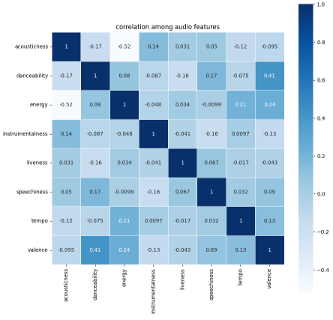
Data Analysis.
Heat map for determining correlation between the dataset attributes
A heat map is a color encoded matrix that is used to depict the correlation between the target variable and the other attributes in the Seaborn data visualization library

Slide 6
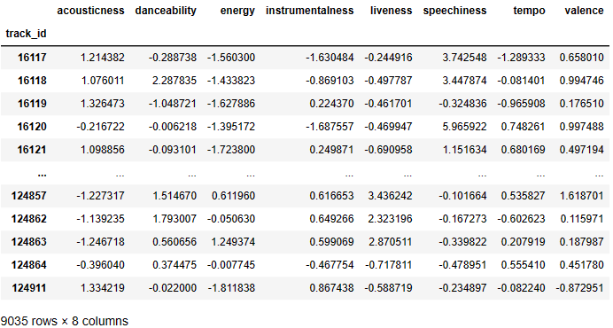
DATA PREPROCESSING
We went through several steps in data preprocessing, including data cleaning, data integration, data reduction, data transformation and Feature scaling.
We remove outliers from our dataset to prevent statistical analysis from being distorted
Feature Scaling

Slide 7
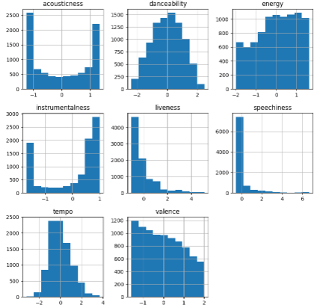
Data Visualization
Relationships between different features are represented in data visualization.

Slide 8
ML Model Implementation
1) KMeans Clustering Model
Apply clustering strategies (e.g., k-means, hierarchical clustering) to identify similarities and connections between different genres.
Cluster audio files based on their attributes to find groups of related tracks.
Use the resulting clusters as additional information for genre classification.
Incorporate unsupervised clustering approaches alongside supervised machine learning algorithms to improve the precision of genre categorization.

Slide 9
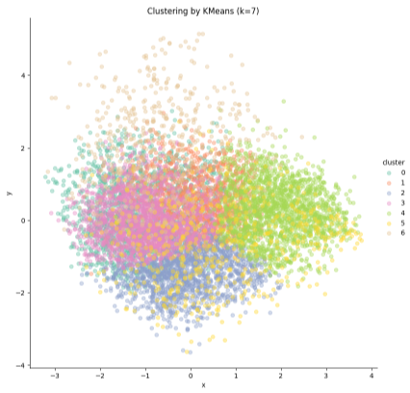
Continue
We can see clearly that the clusters are not separated, so we use k=5

Slide 10
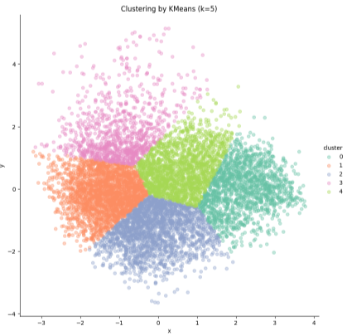
Continue
This could be satisfactory output compared to that of the previous one(k=7)

Slide 11
Continue
SVM Model From the result of Clustering
Implement SVM algorithm for music genre classification using audio attributes.
SVMs are suitable for handling high-dimensional data and can find optimal hyperplanes to separate classes.
Explore various kernel functions (e.g., linear, polynomial, RBF) and tune hyperparameters (e.g., regularization strength) for improved performance.
Consider incorporating spectrogram-based features (e.g., MFCCs) as input representations for SVMs.

Slide 12
Continue
Result Analysis:
The test accuracy score is reported as 0.9247, indicating that the SVM model achieved an accuracy of 92.47% on the unseen test data.
The train accuracy score is reported as 0.9286, which means the model obtained an accuracy of 92.86% on the training data.
These accuracy scores are reasonably high and close to each other, indicating that the SVM model performs well on both the training and test sets.
The fact that the test accuracy is comparable to the train accuracy suggests that the model is not overfitting the training data.

Slide 13
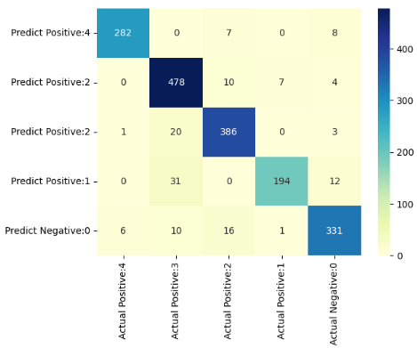
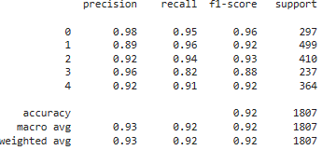
Continue
Confusion Matrix and Classification Report
The confusion matrix allows us to assess the distribution of predicted and actual cluster labels, while the classification report provided a detailed evaluation of the model's performance, including precision, recall, F1-score, and accuracy.

Slide 14
Continue
Random Forest
The random forest algorithm is a bagging method extension that employs both bagging and feature randomness to create an uncorrelated forest of decision trees
Random forest algorithms have three major hyperparameters that must be set prior to training. These variables include node size, number of trees, and number of features sampled. The random forest classifier can then be used to solve regression or classification problems
The random forest algorithm is made up of a collection of decision trees, and each tree in the ensemble is made up of a bootstrap sample, which is a data sample drawn from a training set with replacement
Individual decision trees will be averaged for a regression task, and a majority vote—i.e. the most frequent categorical variable will yield the predicted class for a classification task
Finally, the out of bag sample is used for cross-validation, which completes the prediction.

Slide 15
Continue..
The random forest model is configured with the following settings:
Number of trees: 300
Maximum tree depth: 16
Minimum examples per leaf node: 5
Missing value policy: Global imputation
Categorical attribute handling: Categorical set greedy forward with a sampling rate of 0.1
Winner take all inference strategy
Out-of-bag (OOB) metrics are computed during training
During training, the model progresses by training each tree individually. The Accuracy score for Random forest is 90.16% and a log loss of 0.2981.

Slide 16
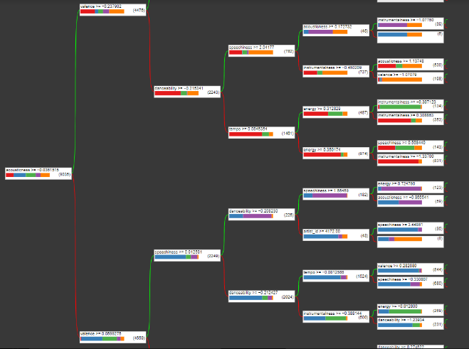
Continue..
Sample of Random Forest

Slide 17
Conclusion
The research aims to develop a reliable and effective system for automatic music genre classification using machine learning algorithms and audio attributes.
The proposed system shows promising results in accurately classifying genres and can enhance user experience in music-related applications.
Performance analysis of classification algorithms (CNN, SVM, KNN) suggests that SVM performs the best in terms of accuracy, F1-score, and consistency.
Random Forest algorithm also shows good performance as an alternative option.

Slide 18
THANK YOU!

